Slide 1
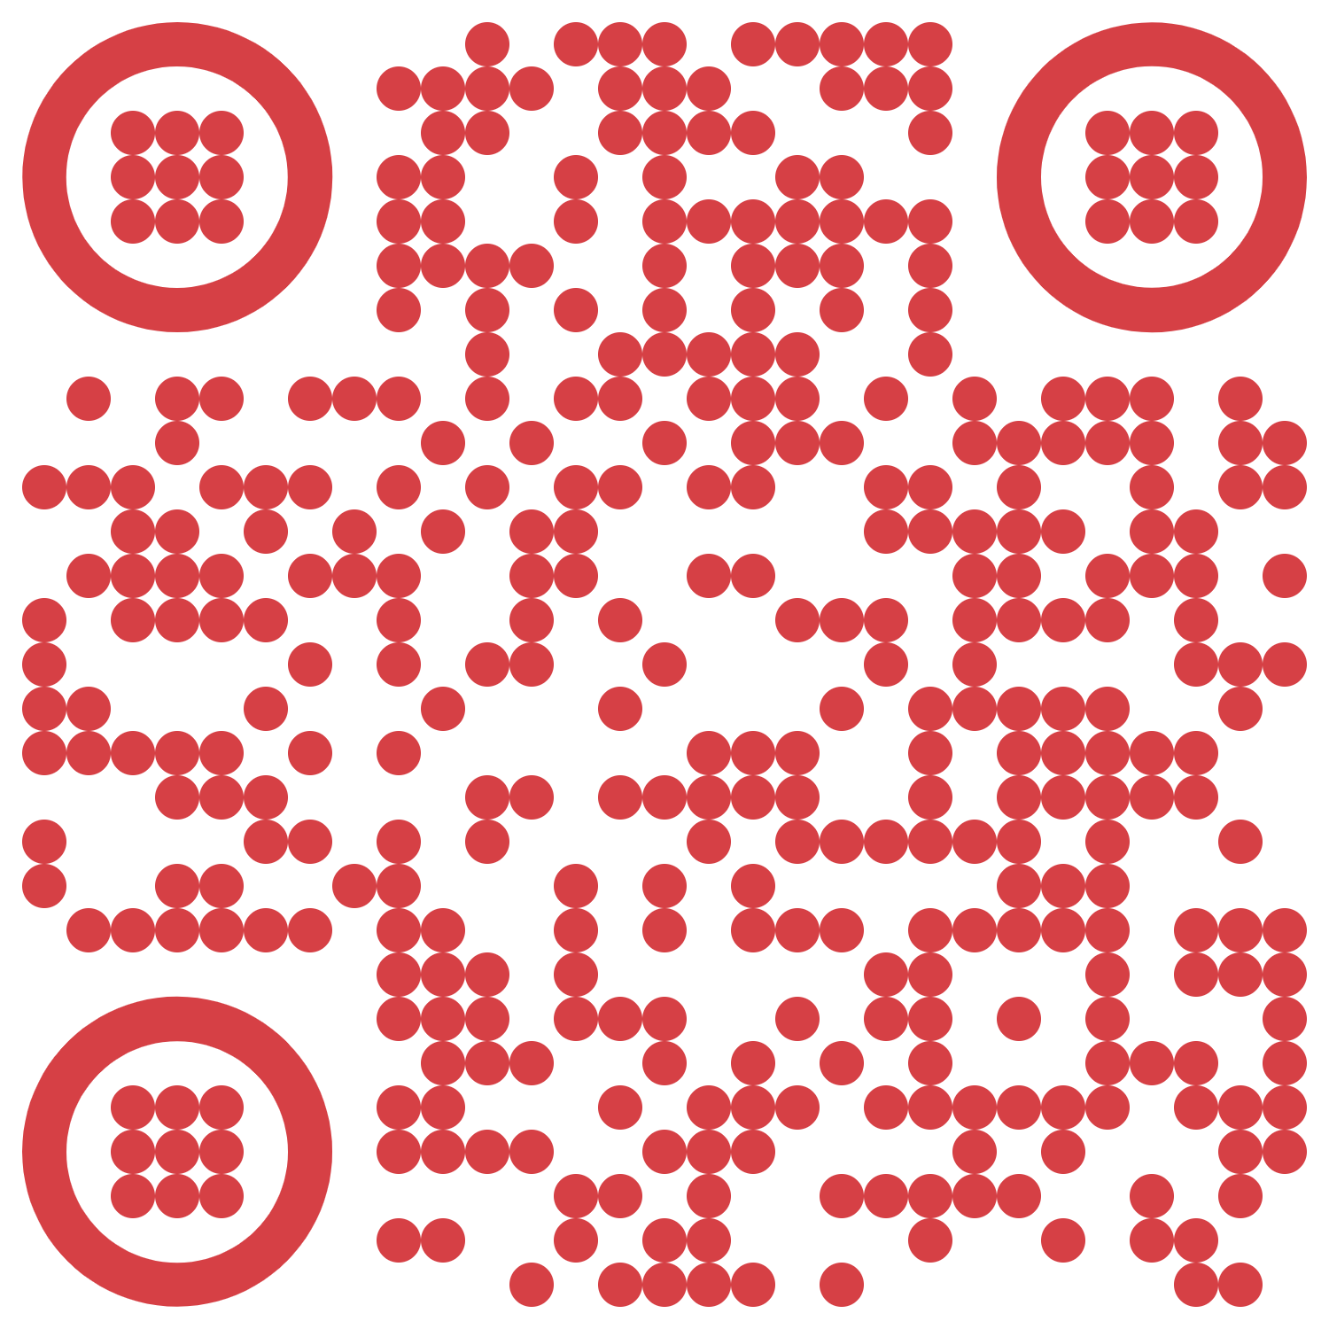

Slide 2
objectives
Derive phase from images projected with phase shifted sinusoids.
Unwrap phase image. (Optional: use quality-guided phase unwrapping algorithm.
Reconstruct 3D from phase difference of reference and object image phase.
The quality of 3D reconstruction using Phase-Shift Profilometry was improved by
implementing the algorithm in a select ROI at a time,
introducing perspective transformation, and
applying Fourier transform filtering to remove visible artifacts.
Physics-301/Activity 08 - Phase Shift Profilometry.ipynb at main · reneprincipejr/Physics-301 (github.com)
https://drive.google.com/file/d/16xJkmief_X15NMBJYi6X5PeF0PFxxntN/view?usp=sharing

Slide 3
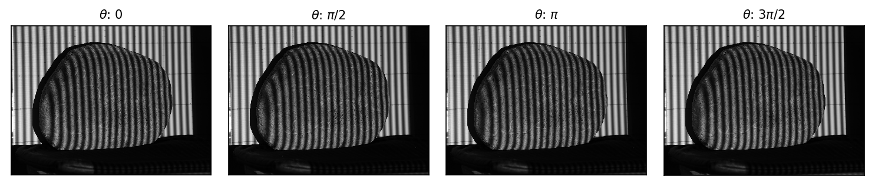
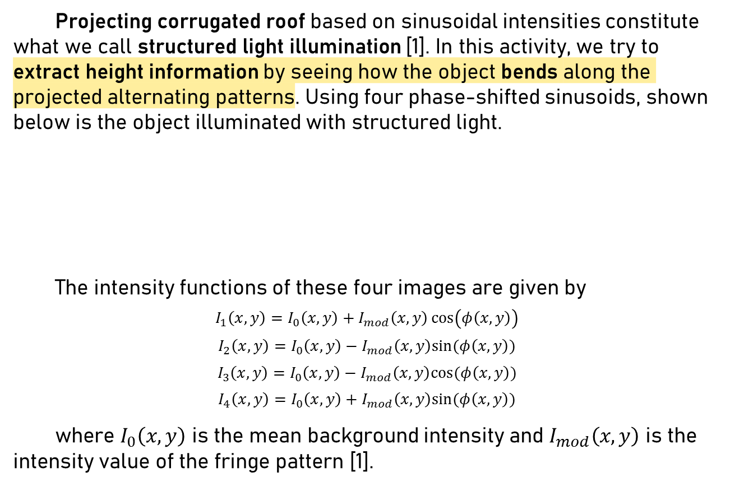
Structured Light
Projecting corrugated roof based on sinusoidal intensities constitute what we call structured light illumination [1]. In this activity, we try to extract height information by seeing how the object bends along the projected alternating patterns. Using four phase-shifted sinusoids, shown below is the object illuminated with structured light.
The intensity functions of these four images are given by
$$I_{1}\left(x,y\right)=I_{0}\left(x,y\right)+I_{mod}\left(x,y\right)\cos\left(φ\left(x,y\right)\right)$$
$$I_{2}\left(x,y\right)=I_{0}\left(x,y\right)−I_{mod}\left(x,y\right)sin⁡(φ\left(x,y\right))$$
$$I_{3}\left(x,y\right)=I_{0}\left(x,y\right)−I_{mod}\left(x,y\right)cos⁡(φ\left(x,y\right))$$
$$I_{4}\left(x,y\right)=I_{0}\left(x,y\right)+I_{mod}\left(x,y\right)sin⁡(φ\left(x,y\right))$$
where $I_{0}\left(x,y\right)$ is the mean background intensity and $I_{mod}\left(x,y\right)$ is the intensity value of the fringe pattern [1].

Slide 4
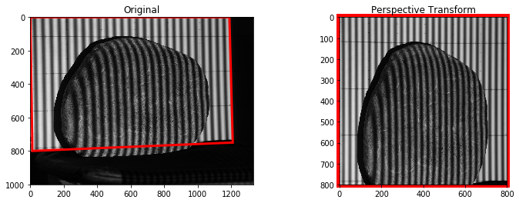
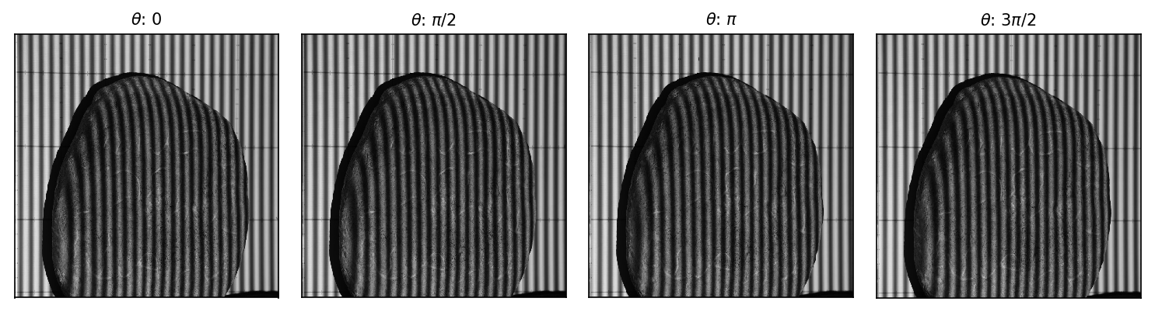
Perspective Transform
Before proceeding, it’s important to note that (1) the images are skewed in perspective and (2) we don’t have the images of flat reference. To address the first problem, we applied warp perspective functions from Open-CV [2].
Shown below are the results of the perspective transform. It’s much more uniform and the uninterrupted sinusoids are now vertically aligned.

Slide 5
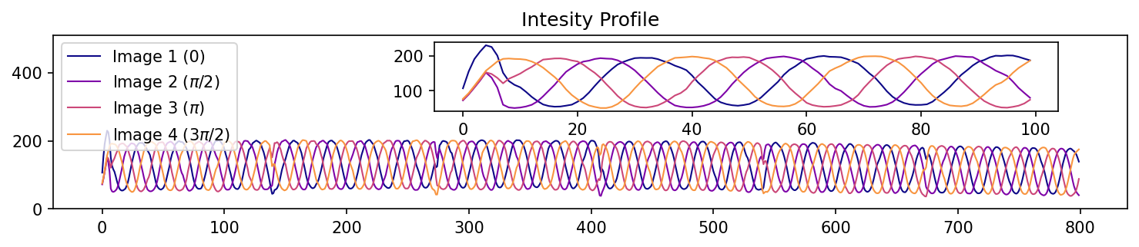
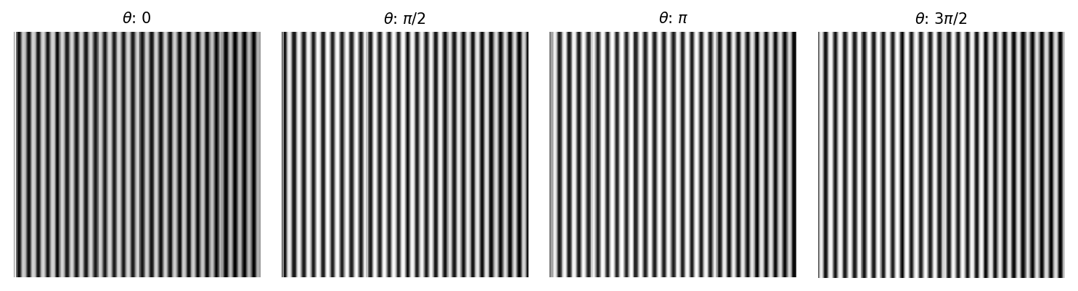
Flat reference
To address (2), we synthetically reconstruct the sinusoidal structured light from the regions in the image where the object doesn’t obstruct the view.
By interpolating background information, we can reconstruct the flat reference image and the results are shown below.

Slide 6
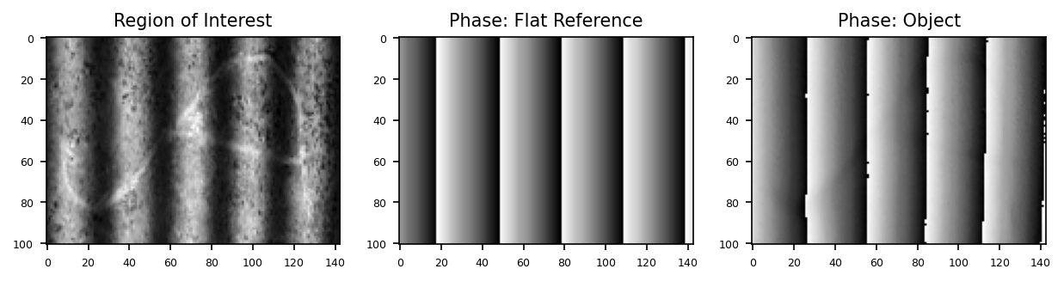
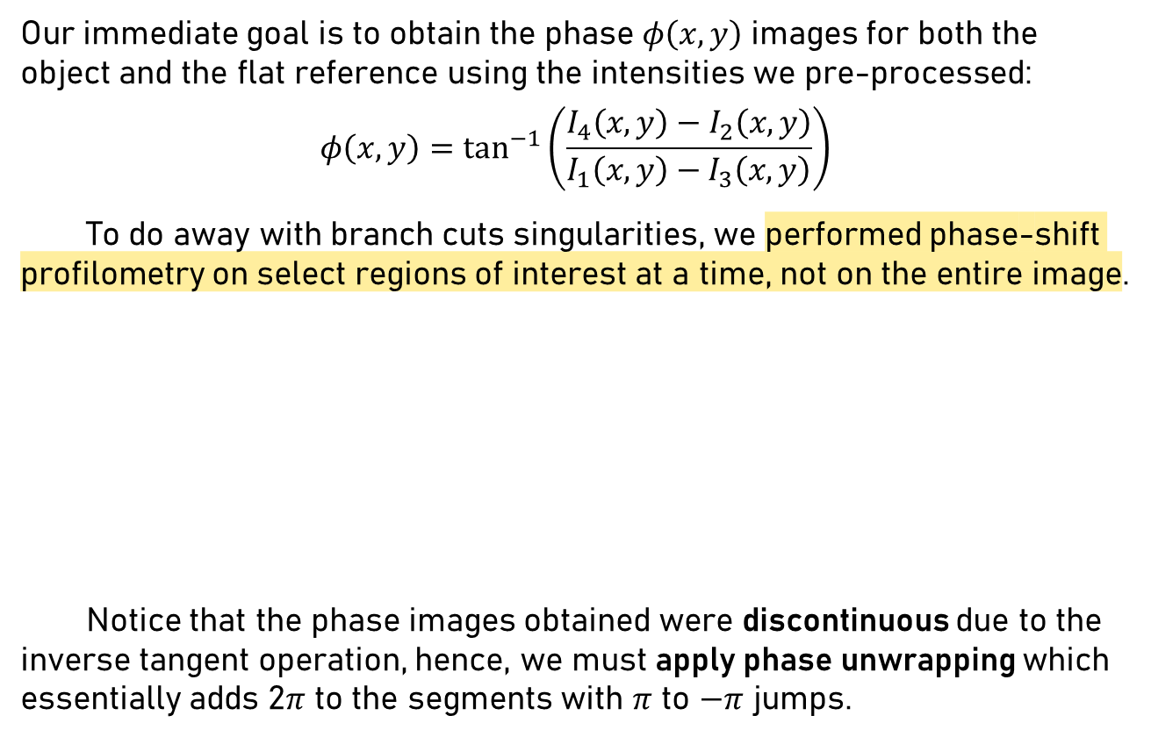
Phase Calculation
Our immediate goal is to obtain the phase $φ\left(x,y\right)$ images for both the object and the flat reference using the intensities we pre-processed:
$$φ\left(x,y\right)=\tan^{−1}\left(\frac{I_{4}\left(x,y\right)−I_{2}\left(x,y\right)}{I_{1}\left(x,y\right)−I_{3}\left(x,y\right)}\right)$$
To do away with branch cuts singularities, we performed phase-shift profilometry on select regions of interest at a time, not on the entire image.
Notice that the phase images obtained were discontinuous due to the inverse tangent operation, hence, we must apply phase unwrapping which essentially adds 2$π$ to the segments with $π$ to $−π$ jumps.

Slide 7
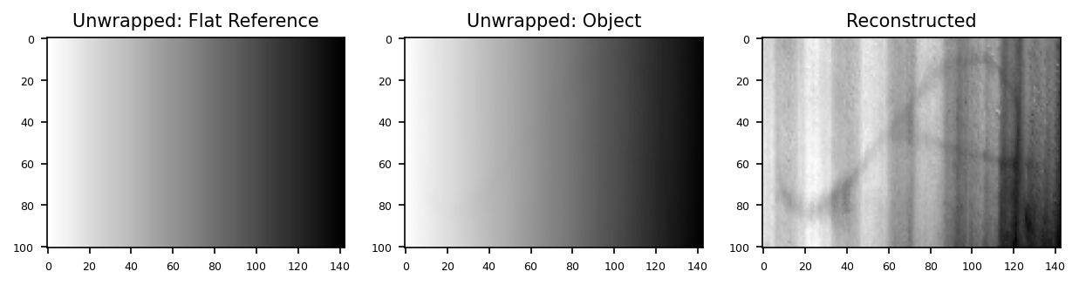
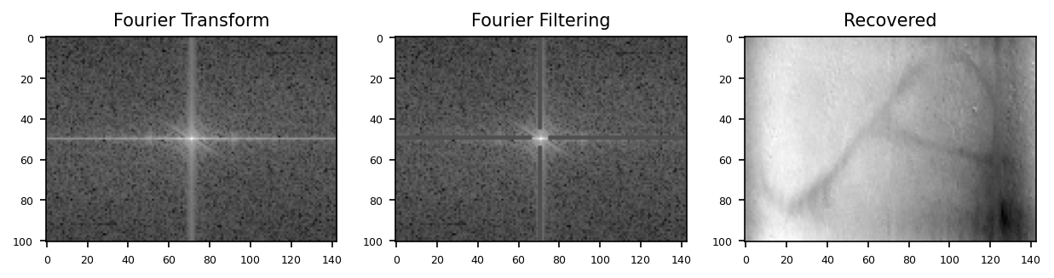
Phase Difference
We can get a rough idea of the height information by getting the phase difference on the unwrapped images of the reference and object as shown:
Notice that there are still noticeable reconstruction artifacts and so, we implement Fourier filtering to remove unwanted frequencies. Results show better reconstruction of the object of interest.

Slide 8
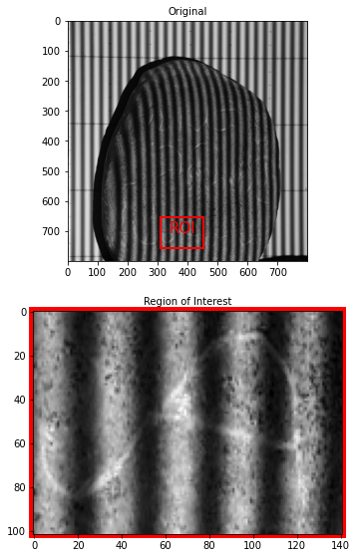
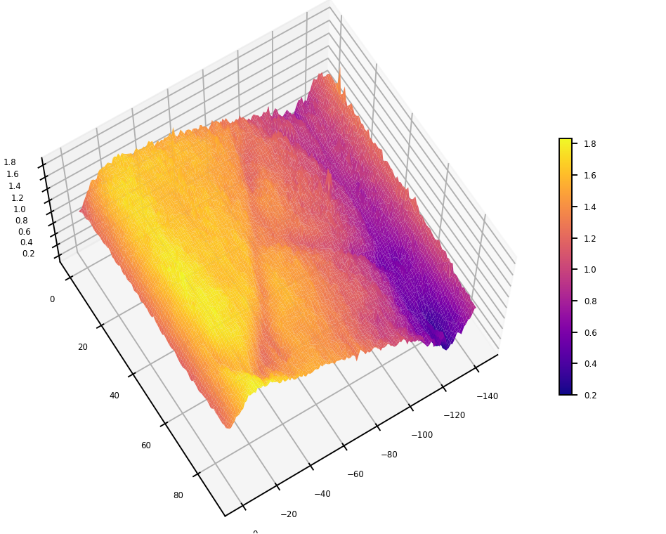
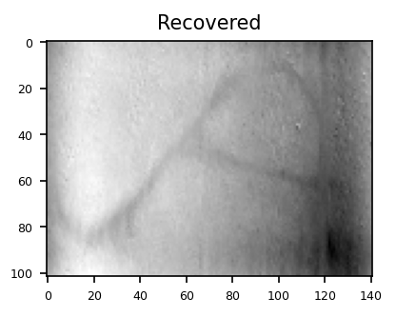
3D Reconstruction

Slide 9
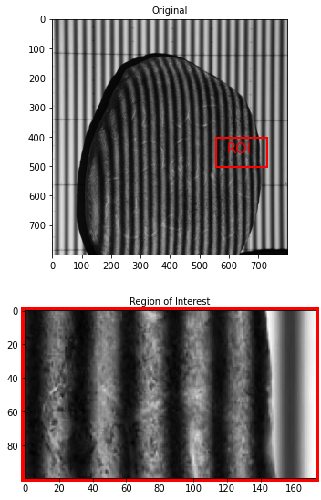
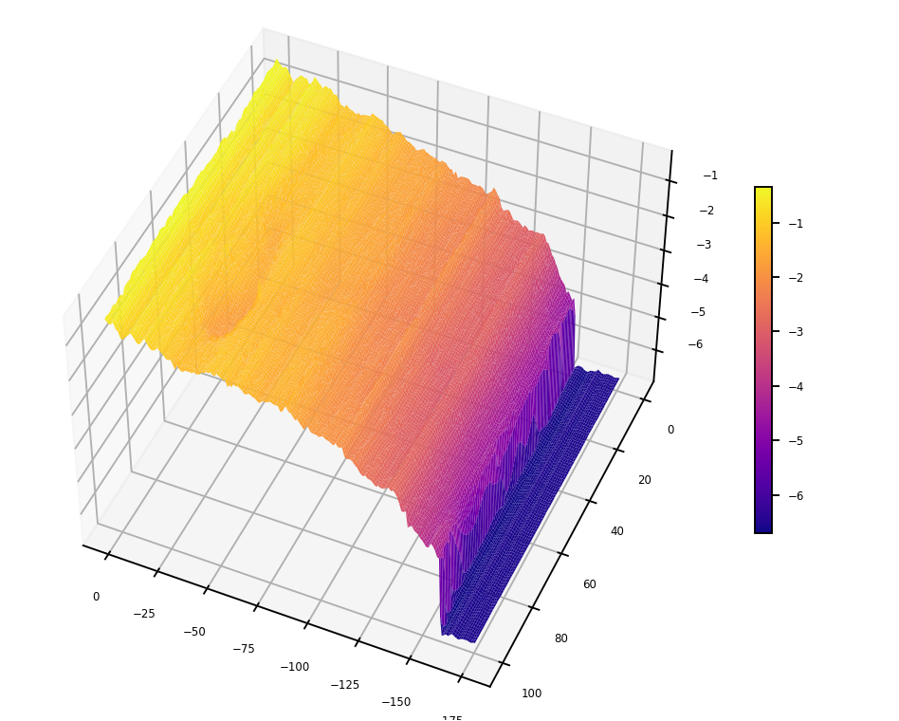
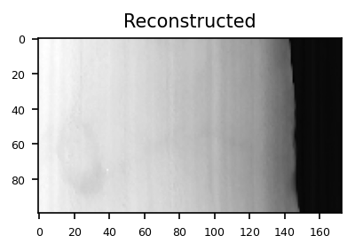
3D Reconstruction

Slide 10
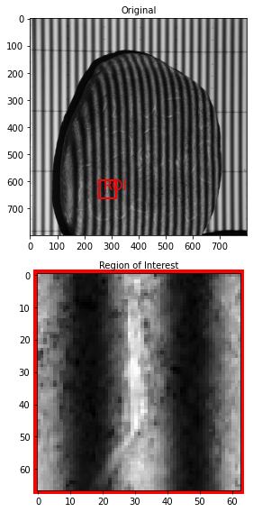
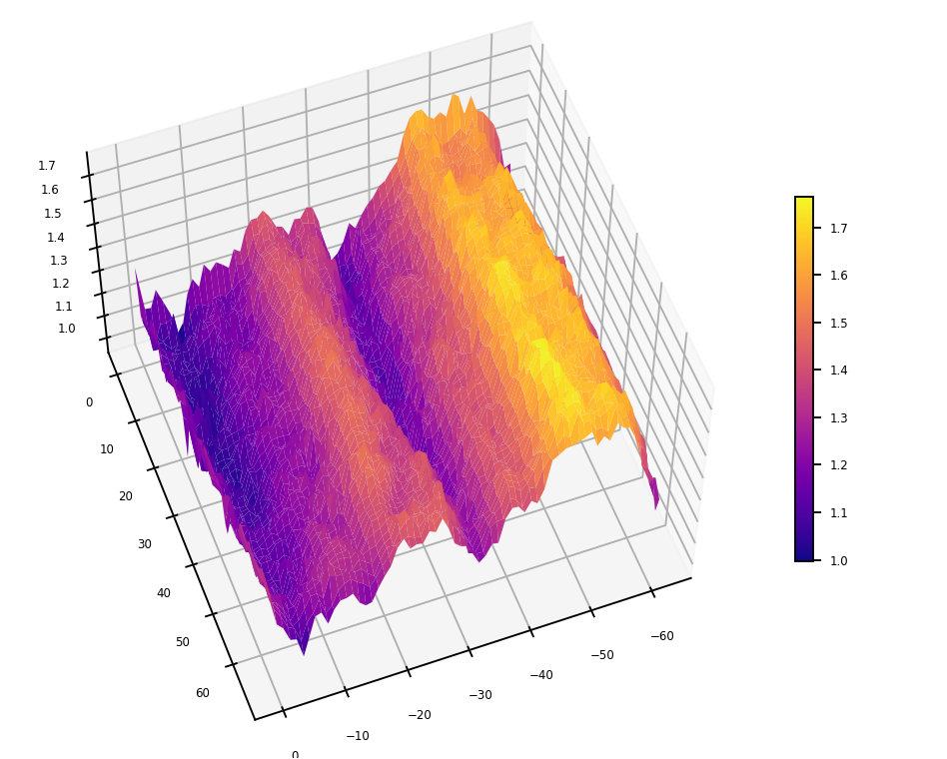
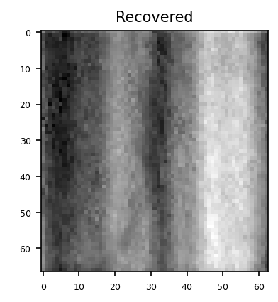
3D Reconstruction

Slide 11
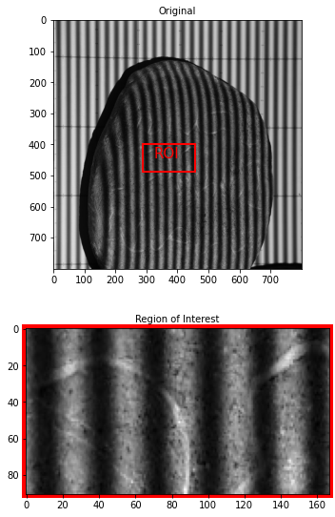
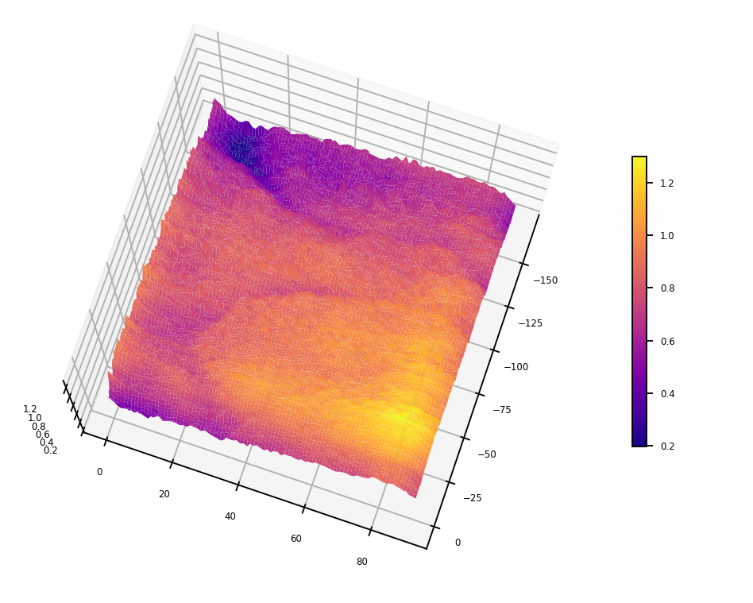
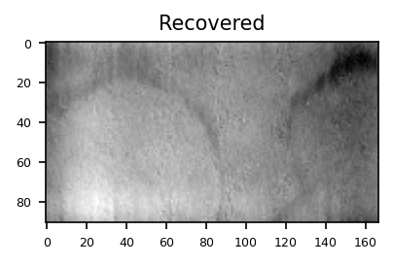
3D Reconstruction

Slide 12
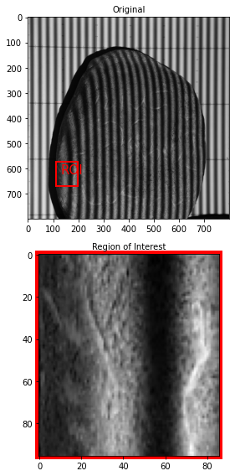
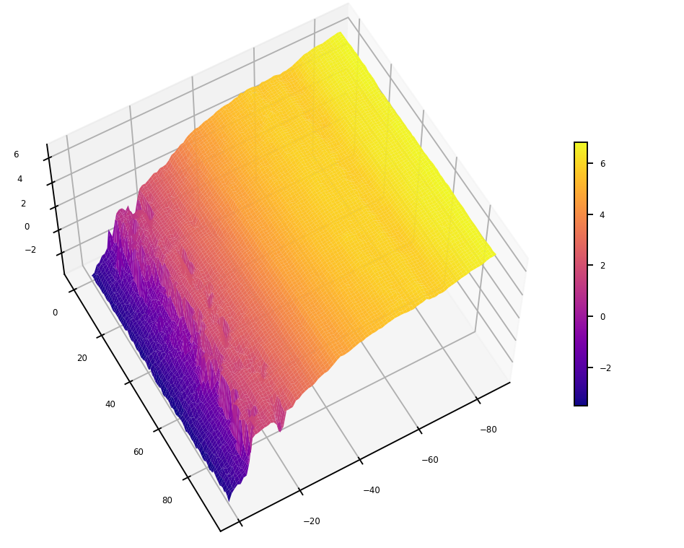
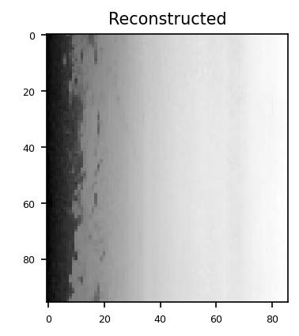
3D Reconstruction

Slide 13
reflection
In conclusion, I was able to implement phase-shift profilometry (PFP) on a challenging object. Additional insights such as synthetically generating the flat reference and performing PFP on select regions of interest were the added-value compared to what we did in App Physics 187. Supplemental steps such as perspective transform and Fourier transform filtering that I implemented in this activity contributed greatly to yielding good qualitative results. 3D mesh maps of the character engravings, the texture, and the shape of the stones were generated accordingly. Unfortunately, I couldn’t explore on implementing quality-guided unwrapping as suggested due to time constraints but considering our current results, I think it would be possible to perform full image PFP with better unwrapping algorithms to eliminate singularities and branch cuts. I genuinely had fun doing this activity and will surely explore the full extent of its strengths and limitations in the future.
With that said, I’d give myself a score of 98/100.
[1] M. Soriano, Physics 301 – Phase Shift Profilometry, (2022).
[2] cv2.warpPerspective() | TheAILearner

